Slide 1
Adversarial Search
1. Minimax
2. Alpha-Beta pruning
Chapter Five In Book

Slide 2
Adversarial Search
Definition
The environment with more than one agent is termed as multi-agent environment,
in which each agent is an opponent of other agent and playing against each other. Each agent needs to consider the action of other agent and effect of that action on their performance.
Searches in which two or more players with conflicting goals are trying to explore the same search space for the solution,
In this chapter we cover competitive environments, in which the agents’
goals are in conflict, giving rise to adversarial search problems—often known as games are called adversarial searches, often known as Games.
In which we examine the problems that arise when we try to plan ahead in a world where other agents are planning against us.

Slide 3
What is a game?
Competitive environments, in which the agents’ goals are in conﬂict, giving rise to adversarial search problems—often known as games.
Mathematical game theory, a branch of economics, views any multiagent environment as a game, provided that the impact of each agent on the others is “signiﬁcant,” regardless of whether the agents are cooperative or competitive.
Games are of a rather specialized kind — what game theorists call deterministic, turn-taking, two-player, zero-sum games of perfect information

Slide 4
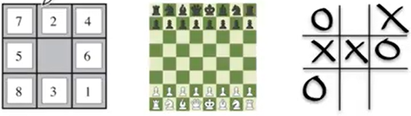
Various games

Slide 5
Games, unlike most of the toy problems, are interesting because they are too hard to solve.
Eg, chess has an average branching factor of about 35, and games often go to 50 moves by each player, so the search tree has about 35^100 or 10^154 nodes.
Games, like the real world, therefore require the ability to make some decision even when calculating the optimal decision is infeasible.
Game-playing research has spawned a number of interesting ideas on how to make the best possible use of time.

Slide 6
We look at techniques for choosing a good move when time is limited.
Pruning allows us to ignore portions of the search tree that make no difference to the ﬁnal choice, and heuristic evaluation functions allow us to approximate the true utility of a state without doing a complete search.

Slide 7
Two player games
Consider games with two players, whom we call MAX and MIN.
MAX moves ﬁrst, and then they take turns moving until the game is over.
At the end of the game, points are awarded to the winning player and penalties are given to the loser.
A game can be formally deﬁned as a kind of search problem with the following elements:

Slide 8
Elements of the game
Consider a game with two players MAX and MIN
  Max moves first and followd by MIN
S₀: The initial state, which speciﬁes how the game is set up at the start.
PLAYER(s): Deﬁnes which player has the move in a state. (takes state s as input, and returns whether it’s the turn of MAX or MIN)
ACTIONS(s): Returns the set of legal moves in a state. (takes state S as inputs and returns what are the possible actions)
RESULT(s,a): The transition model, which deﬁnes the result of a move. (outcome of action taken a on the state s)
TERMINAL-TEST(s):A terminal test, which is true when the game is over and false otherwise. (returns true is terminal state, otherwise false)
States where the game has ended are called Terminal states.
UTILITY(s,p):A utility function (also called an objective function or pay off function), deﬁnes the ﬁnal numeric value for a game that ends in terminal state s for a player p. In chess, the outcome is a win, loss, or draw, with values +1, 0, or 1/2.

Slide 9
A normal search problem:
  The optimal solution is a sequence of actions leading to a goal state
  An Adverserial search problem:
  Min interferes the sequence of action of the MAX player
  Strategy for Max:
    Specify moves in the initial state
    Observe every possible response by MIN
    Specify moves in response
    This optimal strategy can be determined from the minimax value of each node

Slide 10
Zero Sum Game
A zero-sum game is (confusingly) deﬁned as one where the total payoff to all players is the same for every instance of the game.
Chess is zero-sum because every game has payoff of either 0+1, 1 + 0, ½ + ½ .
The initial state, ACTIONS function, and RESULT function deﬁne the game tree for the game—a tree where the nodes are game states and the edges are moves.

Slide 11
Sample game – tic tac toe
Play a sample game of Tic tac toe.
x
 | o

Slide 12
MAX-MIN
Part of the game tree for tic-tac-toe.
From the initial state, MAX has nine possible moves.
Play alternates between MAX’s placing an X and MIN’s placing an O until we reach leaf nodes corresponding to terminal states such that one player has three in a row or all the squares are ﬁlled.
The number on each leaf node indicates the utility value of the terminal state from the point of view of MAX; high values are assumed to be good for MAX and bad for MIN.

Slide 13
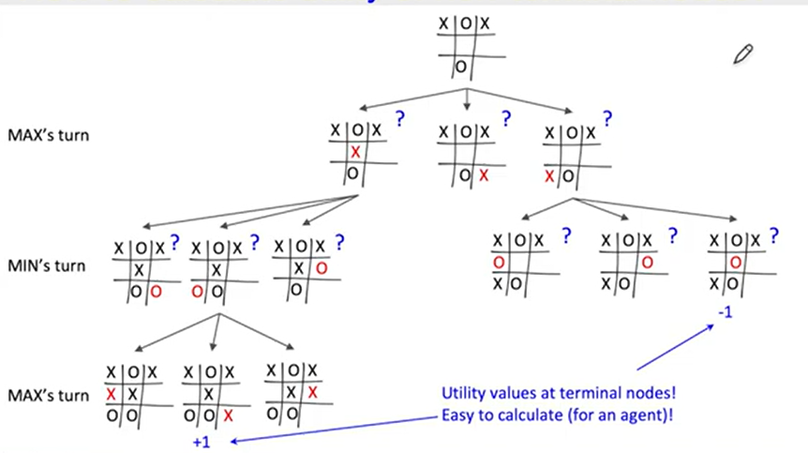
How can we compute the score of the intermediate
nodes or the non-terminal nodes?
Answer: MINIMAX value

Slide 14
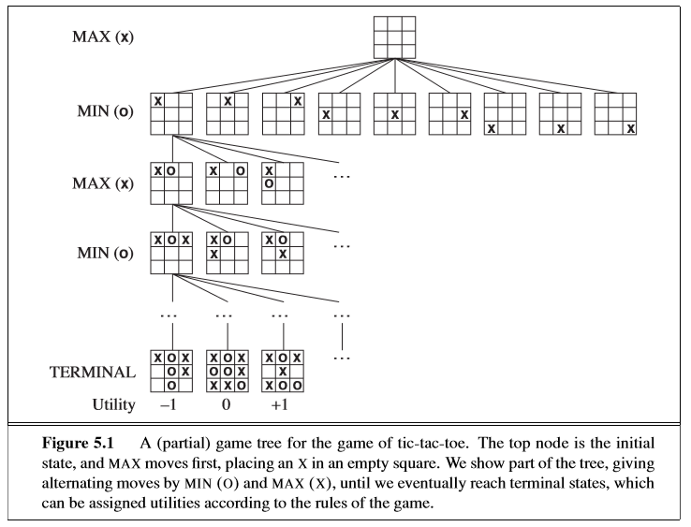

Slide 15
For tic-tac-toe the game tree is relatively small—fewer than 9! = 362,880 terminal nodes.
But for chess there are over 1040 nodes, so the game tree is best thought of as a theoretical construct that we cannot realize in the physical world.

Slide 16
In a normal search problem, the optimal solution would be a sequence of actions leading to a goal state—a terminal state that is a win.
In adversarial search, MIN has something to say about it. MAX therefore must ﬁnd a contingent strategy, which speciﬁes MAX’s move in the initial state, then MAX’s moves in the states resulting from every possible response by MIN, then MAX’s moves in the states resulting from every possible response by MIN to those moves, and so on.

Slide 17
Roughly speaking, an optimal strategy leads to outcomes at least as good as any other strategy when one is playing an infallible opponent.
Even a simple game like tic-tac-toe is too complex for us to draw the entire game tree, so switch to the trivial game.

Slide 18
Sample Game
The possible moves for MAX at the root node are labeled a1, a2, and a3. The possible replies to a1 for MIN are b1, b2, b3, and so on.
This particular game ends after one move each by MAX and MIN.
In game parlance, we say that this tree is one move deep, consisting of two half-moves, each of which is called a ply.
The utilities of the terminal states in this game range from 2 to 14.

Slide 19
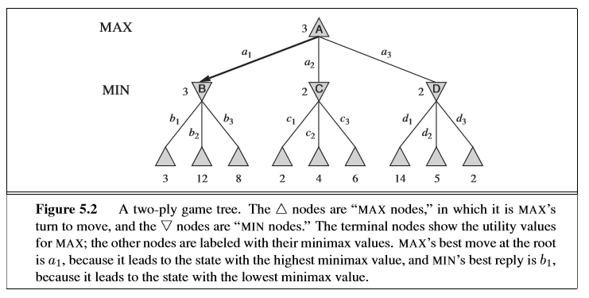

Slide 20
MINIMAX(n)
Given a game tree, the optimal strategy can be determined from the minimax value of each node, which we write as MINIMAX(n).
The minimax value of a node is the utility (for MAX) of being in the corresponding state, assuming that both players play optimally from there to the end of the game.
Obviously, the minimax value of a terminal state is just its utility. Furthermore, given a choice, MAX prefers to move to a state of maximum value, whereas MIN prefers a state of minimum value.

Slide 21
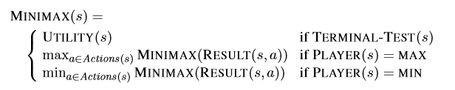
Minimax function

Slide 22
The terminal nodes on the bottom level get their utility values from the game’s UTILITY function.
The ﬁrst MIN node, labeled B, has three successor states with values 3, 12, and 8, so its minimax value is 3.
Similarly, the other two MIN nodes have minimax value 2.
The root node is a MAX node; its successor states have minimax values 3, 2, and 2; so it has a minimax value of 3.

Slide 23
The minimax decision at the root: action a1 is the optimal choice for MAX because it leads to the state with the highest minimax value.
This deﬁnition of optimal play for MAX assumes that MIN also plays optimally—it maximizes the worst-case outcome for MAX. What if MIN does not play optimally? Then it is easy to show that MAX will do even better.

Slide 24
The minimax algorithm computes the minimax decision from the current state.
It uses a simple recursive computation of the minimax values of each successor state, directly implementing the deﬁning equations.
The recursion proceeds all the way down to the leaves of the tree, and then the minimax values are backed up through the tree as the recursion unwinds.

Slide 25
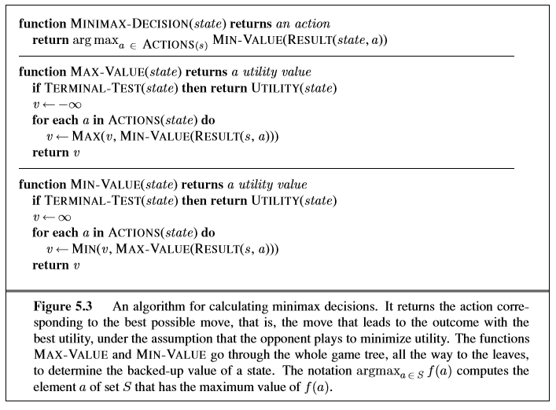

Slide 26
For example, the algorithm ﬁrst recurses down to the three bottom left nodes and uses the UTILITY function on them to discover that their values are 3, 12, and 8, respectively. Then it takes the minimum of these values, 3, and returns it as the backed up value of node B. A similar process gives the backed-up values of 2 for C and 2 for D.
Finally, we take the maximum of 3, 2, and 2 to get the backed-up value of 3 for the root node.

Slide 27
Utility function vs Minimax function
Utility (s, p)
  Defines the final numeric value for a game that ends in a terminal state s for a player P (/ these values are defined only for terminal states)
Minimax (s, p)
  Defines the numeric values at all other nodes

Slide 28
Time and Space Complexity
The minimax algorithm performs a complete depth-ﬁrst exploration of the game tree.
If the maximum depth of the tree is m and there are b legal moves at each point,
then the time complexity of the minimax algorithm is O(b^{m}).
The space complexity is O(bm) for an algorithm that generates all actions at once, or O(m) for an algorithm that generates actions one at a time

Slide 29
Properties of minimax
Complete? Yes (if tree is finite)
Optimal? Yes (against an optimal opponent)
Time complexity? O(bm)
Space complexity? O(bm) (depth-first exploration)
For chess, b ≈ 35, m ≈100 for "reasonable" games_x000b_→ exact solution completely infeasible

Slide 30
Alpha-Beta pruning

Slide 31
α-β pruning
The problem with minimax search is that number of game states it has to examine is exponential in the depth of tree.
can’t eliminate the exponent, but can effectively cut it in half.
The trick is that it is possible to compute the correct minimax decision without looking at every node in the game tree.
The particular technique is called alpha–beta pruning.
When applied to a standard minimax tree, it returns the same move as minimax would, but prunes away branches that cannot possibly inﬂuence the ﬁnal decision.

Slide 32
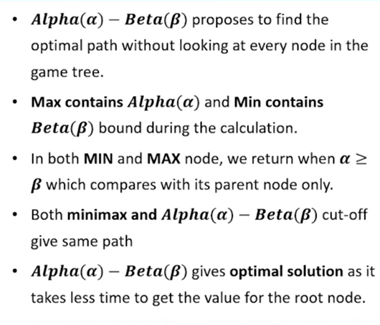
Steps of Alpha-Beta pruning algorithm

Slide 33
Properties of α-β
Pruning does not affect final result
  → doubles depth of search
Good move ordering improves effectiveness of pruning
With "perfect ordering," time complexity = O(bm/2)

Slide 34
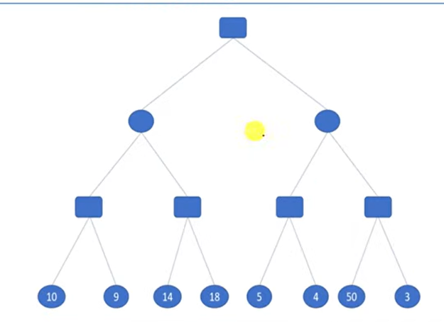
Example of Alpha-Beta pruning

Slide 35
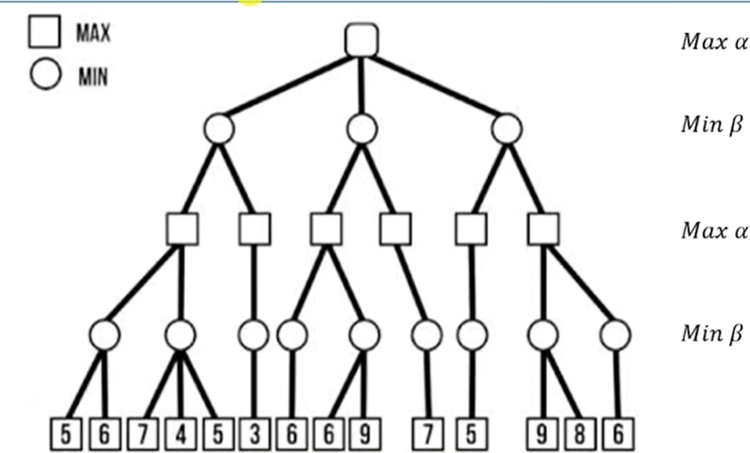
Example 2:

Slide 36
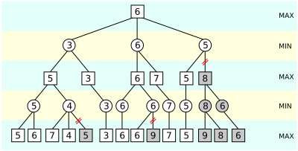
Solution: 2

